Slide 1
Binary Trees
Chapter 6

Slide 2
Objectives
Trees, Binary Trees, and Binary Search Trees
Tree Traversal
Implementing Binary Trees
Binary Search Tree
Insertion
Deletion
Balancing a Tree
The DSW Algorithm (*)
AVL Trees
Heaps
Polish Notation and Expression Trees (*)
Reading at home
Notes:
Note: (*) Means that students are required to understand essential features only (the problem explanation, definitions, the outline of algorithms…), not in details.

Slide 3
DAY 3 TREES

Slide 4
AVL Trees
Balancing tree after inserting, deleting a node
Notes:
Adelson, Velskii, and Landis

Slide 5
AVL Trees
ALV tree (by Adelson, Velskii, and Landis) is balanced binary search tree with condition
Height of the left and right subtrees of every node differ by at most one
A balance factor is the height of the right subtree minus the height of the left subtree.
ALV tree, balance factors of all nodes should be +1, 0, or -1.
Note also that: Definition of AVL tree is the same as that of the balanced tree.
However, the concept of AVL tree always implicitly includes
the techniques for finding balance factors and
balancing the tree.

Slide 6
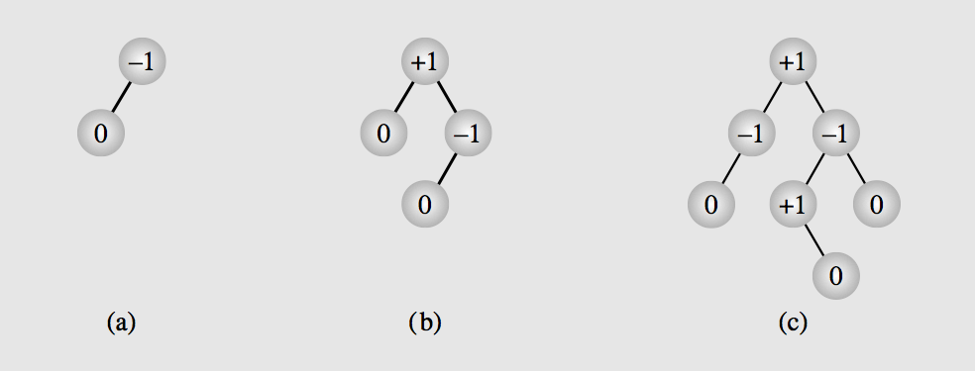
Balance factors of nodes
Is defined as height of the right subtree minus height of left subtree.

Slide 7
Insertion and rebalancing

Slide 8
Insertion in an AVL Tree
After insertion if the balance factor of AVL tree becomes less than -1 or greater than 1, the tree has to be re-balanced.
Four cases, however, two cases to be analyzed and the other two will be symmetrically the same
First case: inserting into the right subtree of the right child
Second case: inserting into the left subtree of the right child

Slide 9
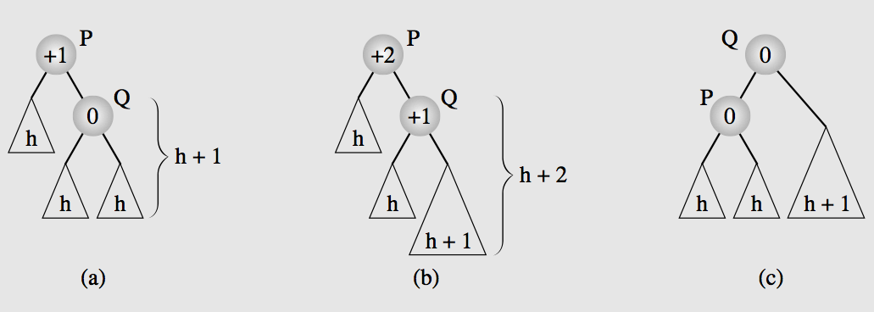
First case: To right subtree of right child
Inserting a node to the right subtree of the right child
Rotate Q about P

Slide 10
First case: To right subtree of right child
+1
0
0
0
0
0
0
0
0
0
0

Slide 11
First case: To right subtree of right child
Balance disturbance
+1
+2
0
+1
0
0
0
0
+1
0
0
0
+1
0
0
0

Slide 12
First case: To right subtree of right child
Balance disturbance
P
+1
+2
Q
0
+1
0
0
0
0
+1
0
0
0
+1
0
0
0
Rotate Q about P

Slide 13
First case: To right subtree of right child
P
+1
+2
Q
0
+1
0
0
0
+1
0
0
0
0
+1
0
0
0
Rotate Q about P

Slide 14
First case: To right subtree of right child
P
+1
+2
Q
0
+1
0
0
0
+1
0
0
0
+1
0
0
0
0
Rotate Q about P

Slide 15
First case: To right subtree of right child
P
Q
0
+1
+1
+2
0
0
+1
0
0
0
+1
0
0
0
0
0
Rotate Q about P

Slide 16
First case: To right subtree of right child
Q
0
+1
P
+1
+2
0
0
+1
0
0
+1
0
0
0
0
0
0
Rotate Q about P

Slide 17
First case: To right subtree of right child
Q
0
+1
P
+1
+2
0
0
+1
0
0
+1
0
0
0
0
0
0
Rotate Q about P

Slide 18
First case: To right subtree of right child
Q
0
+1
P
+1
+2
0
+1
0
0
0
+1
0
0
0
0
0
0
Rotate Q about P

Slide 19
First case: To right subtree of right child
Q
0
+1
P
+1
+2
0
+1
0
0
+1
0
0
0
0
0
0
0
Rotate Q about P

Slide 20
First case: To right subtree of right child
Q
0
+1
P
0
+2
+1
+1
+1
0
+1
0
0
0
0
0
0
0
Rotate Q about P

Slide 21
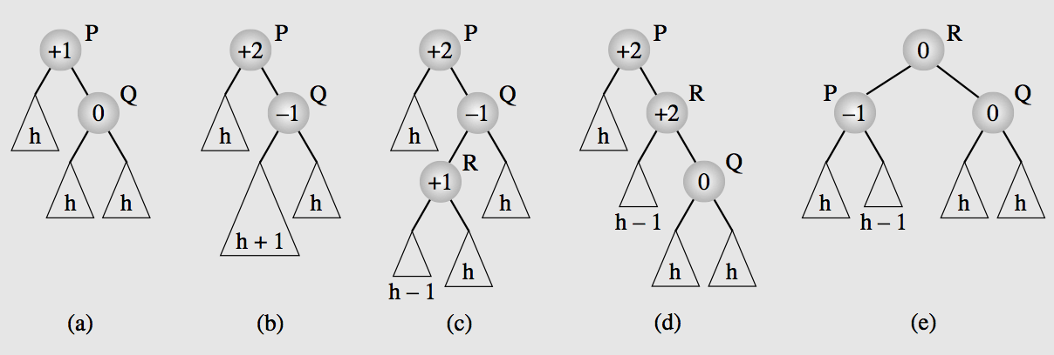
Second case: to left subtree of right child
Inserting a node to the left subtree of the right child (more complex)
A double rotation is needed.
First: Rotating R about Q and then
Second: R about P

Slide 22
Second case: to left subtree of right child
Balance disturbance
P
+1
+2
Q
0
-1
0
R
0
0
0
0
+1
0
0
0
0
+1
0
First: Rotate R about Q
Second: Rotate R about P

Slide 23
Second case: to left subtree of right child
P
+1
+2
Q
0
+1
0
R
0
0
0
0
+1
0
0
0
0
+1
0
First: Rotate R about Q
Second: Rotate R about P

Slide 24
Second case: to left subtree of right child
P
+1
+2
0
Q
0
+1
R
0
0
0
+1
0
0
0
+1
0
0
0
First: Rotate R about Q
Second: Rotate R about P

Slide 25
Second case: to left subtree of right child
P
+1
+2
0
R
Q
0
+1
0
+1
0
0
0
0
+1
0
0
0
0
First: Rotate R about Q
Second: Rotate R about P

Slide 26
Second case: to left subtree of right child
P
+1
+2
R
0
0
+1
Q
0
+1
0
0
0
0
+1
0
0
0
0
First: Rotate R about Q
Second: Rotate R about P

Slide 27
Second case: to left subtree of right child
P
+1
+2
R
0
0
+1
Q
0
+1
0
0
0
0
0
+1
0
0
0
First: Rotate R about Q
Second: Rotate R about P

Slide 28
Second case: to left subtree of right child
P
+1
+2
R
0
+1
0
Q
0
+1
0
0
0
0
0
+1
0
0
0
First: Rotate R about Q
Second: Rotate R about P

Slide 29
Second case: to left subtree of right child
P
+1
+2
R
0
+1
0
Q
0
+1
0
0
0
0
0
+1
0
0
0
First: Rotate R about Q
Second: Rotate R about P

Slide 30
Second case: to left subtree of right child
P
+1
+2
R
0
+1
Q
0
0
+1
0
0
0
0
0
+1
0
0
0
First: Rotate R about Q
Second: Rotate R about P

Slide 31
Second case: to left subtree of right child
P
+1
+2
R
0
+1
Q
0
+1
0
0
0
0
+1
0
0
0
0
0
First: Rotate R about Q
Second: Rotate R about P

Slide 32
Second case: to left subtree of right child
R
0
+1
P
Q
0
+1
+1
+2
0
0
0
+1
0
0
0
0
0
0
First: Rotate R about Q
Second: Rotate R about P

Slide 33
Second case: to left subtree of right child
R
0
+1
P
Q
0
+1
+1
+2
0
0
0
+1
0
0
0
0
0
0
First: Rotate R about Q
Second: Rotate R about P

Slide 34
Second case: to left subtree of right child
R
0
+1
P
Q
0
+1
+1
+2
0
0
+1
0
0
0
0
0
0
0
First: Rotate R about Q
Second: Rotate R about P

Slide 35
Second case: to left subtree of right child
R
0
+1
P
Q
0
+1
+1
+2
0
0
+1
0
0
0
0
0
0
0
First: Rotate R about Q
Second: Rotate R about P

Slide 36
Second case: to left subtree of right child
R
0
+1
P
Q
0
-1
+1
+2
+1
0
+1
0
0
0
0
0
0
0
First: Rotate R about Q
Second: Rotate R about P

Slide 37
In a larger AVL tree
ALV tree seen before might be child of some other node in the tree
If a node is entered to the tree and the balance of P is disturbed and then restored.
Does extra work needed to be done for the predecessor(s) of P?
Fortunately, NO, since after rotation height of the new tree is exactly the same as that of the previous one.
Which mean the balance factor of parent of the new root (Q in previous example) remains the same

Slide 38
In a larger AVL tree
Now the general solution is:
Find a node P for which the balance factor becomes unacceptable after a node is inserted
This is detected by moving up toward the root from newly inserted node
If the old balance factor is +-1 it might be changed to +-2
The first node whose balance factor is changed to +-2 becomes the root P of a subtree that we need to balance
Balance factors for the nodes, above this node doesn’t need to be updated
Coz after balancing new tree has the same height as the old one

Slide 39
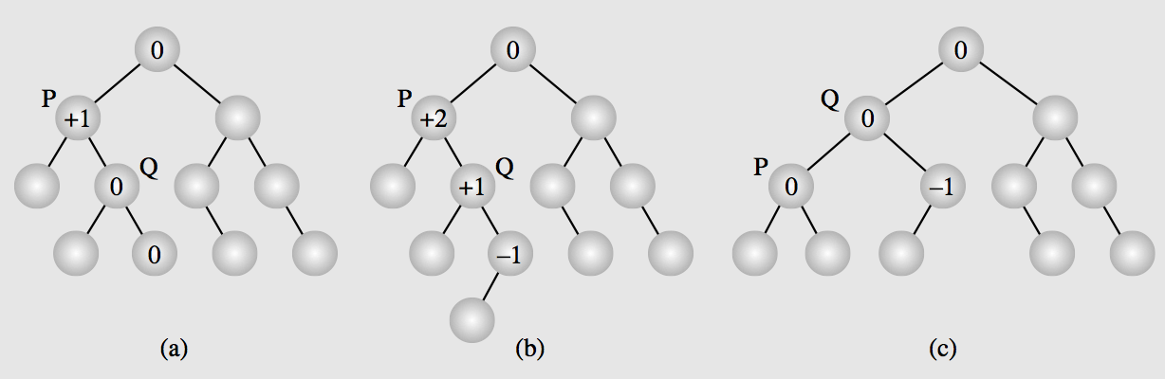
In a larger AVL tree
From the inserted node
Find balance factors of all nodes on this path
Up until finding a node with balance factor = +2
This node P is the root node for us to apply rotation algorithm (2 cases studied above)

Slide 40
Deletion and rebalancing

Slide 41
Deletion
First, apply deleteByCopying() to delete the node
After the node is deleted, balance factors are updated from the parent up to the root.
For each node in this path, whose balance factor becomes +-2, a single or double rotation has to be done.
Important, it doesn’t stop after the first ode P is found, as in case of Insertion.

Slide 42
Cases of immediate rotation
Four cases + corresponding symmetric cases.
Case 1: A root node P with balance factor +1 and right child Q with balance factor +1
Case 2: A root node P with balance factor +1 and right child Q with balance factor 0
A root node P with balance factor +1 and right child Q with balance factor -1
Case 3: The left child R of Q has balance factor of -1
Case 4: The right child R of Q has balance factor of +1

Slide 43
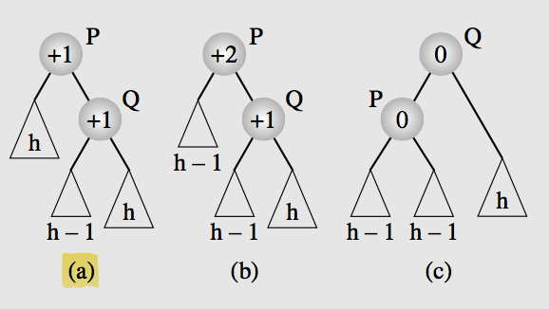
Case 1: P: +1, Q: +1
Case 1: A root node P with balance factor +1 and right child Q with balance factor +1
Rotate Q about P

Slide 44
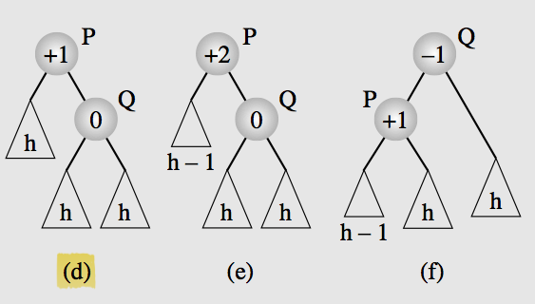
Case 2: P:+1, Q:0
Case 2: A root node P with balance factor +1 and right child Q with balance factor 0
Rotate Q about P (So the same as case 1)

Slide 45
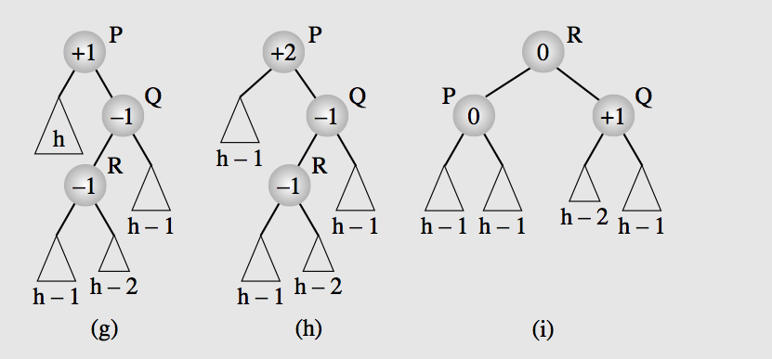
Case 3: P:+1, Q:-1, R:-1
A root node P with balance factor +1 and right child Q with balance factor -1
Case 3: The left child R of Q has balance factor of -1
First: Rotate R about Q
Second: Rotate R about P

Slide 46
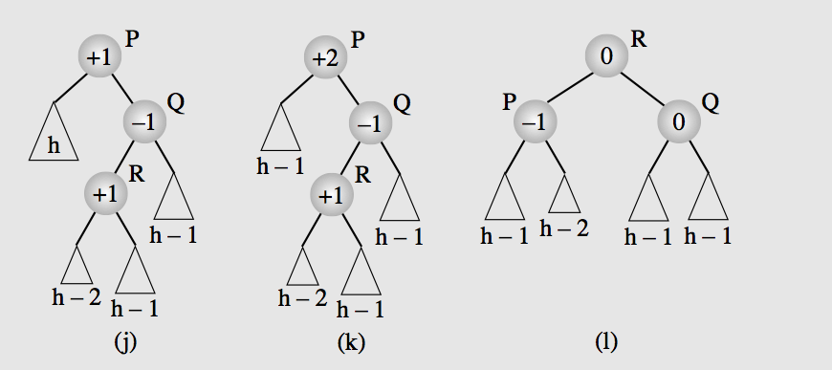
Case 4:
A root node P with balance factor +1 and right child Q with balance factor -1
Case 4: The right child R of Q has balance factor of +1
First: Rotate R about Q
Second: Rotate R about P
(Same as case 3, both cases can be processed in the same way)

Slide 47
Heaps
Heaps as Arrays, Heaps as Priority Queues

Slide 48
Heaps as Arrays

Slide 49
Heap
Particular kind of binary tree, called heap, has two properties
Value of each node is greater than or equal to the values of its children
The tree is nearly complete, i.e. it is perfectly balanced, and leaves in the last level are all in the left most positions first.
These two properties define a max heap.
If “greater” in the first property is replaced with “less”, then the definition specifies a min heap.
Heap is used as Priority Queue and for heap-sorting

Slide 50
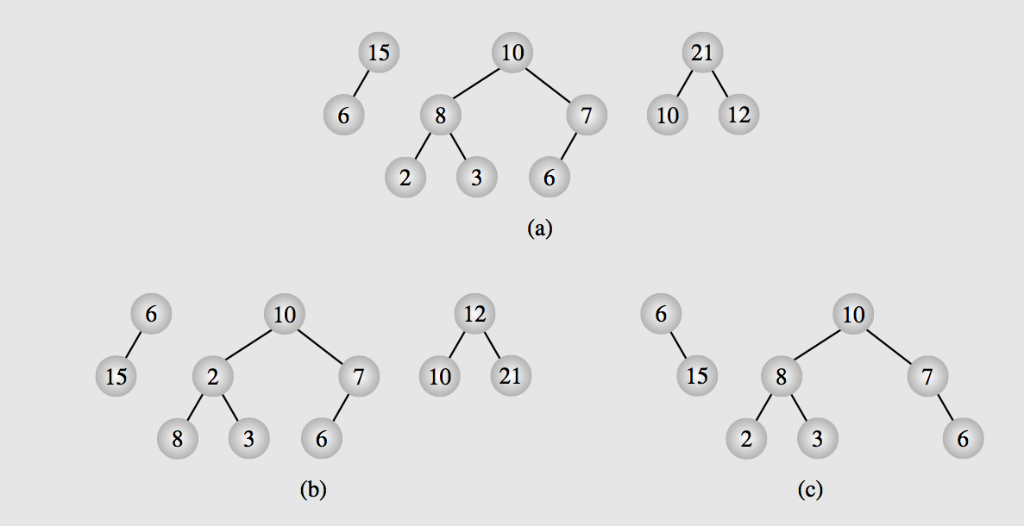
Examples of heaps and non-heap
Notes:
heaps (a) and non-heaps (b, c)

Slide 51
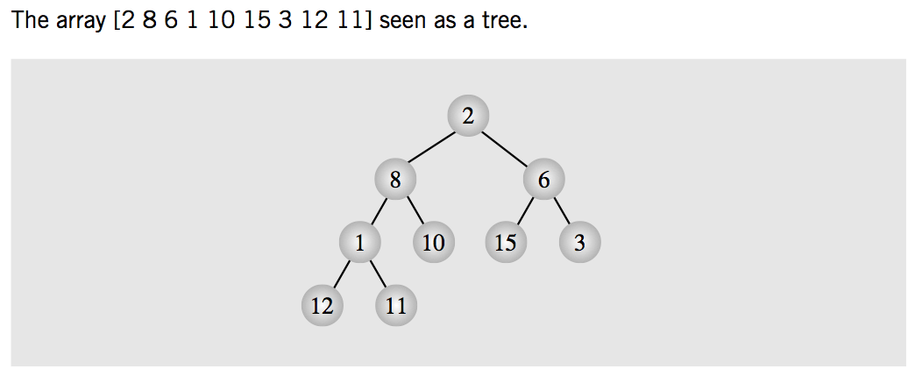
Heaps can be implemented by arrays
Array seen as tree (probably non-heap)
Non-heap tree:
Elements of array are placed sequentially level to level and left to right

Slide 52
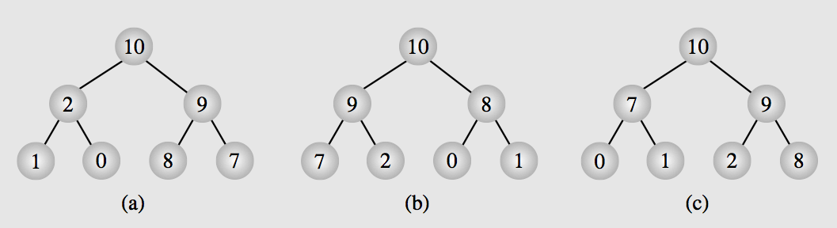
Heaps can be implemented by arrays
Array seen as heap tree
Array can be represented by many heaps
Since heap only decides the order from level to level, not among siblings (same level)

Slide 53
Heaps as Priority Queue

Slide 54
Heaps as Priority Queues
Heap is an excellent way to implement a priority queue.
Two procedures needed to enqueue and dequeue elements from this heap.

Slide 55
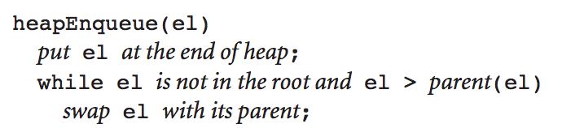
Enqueue to a Heap
To enqueue, element is added at the end of the heap as last leaf
Restoring the heap property is achieved by moving from the last leaf toward the root.

Slide 56
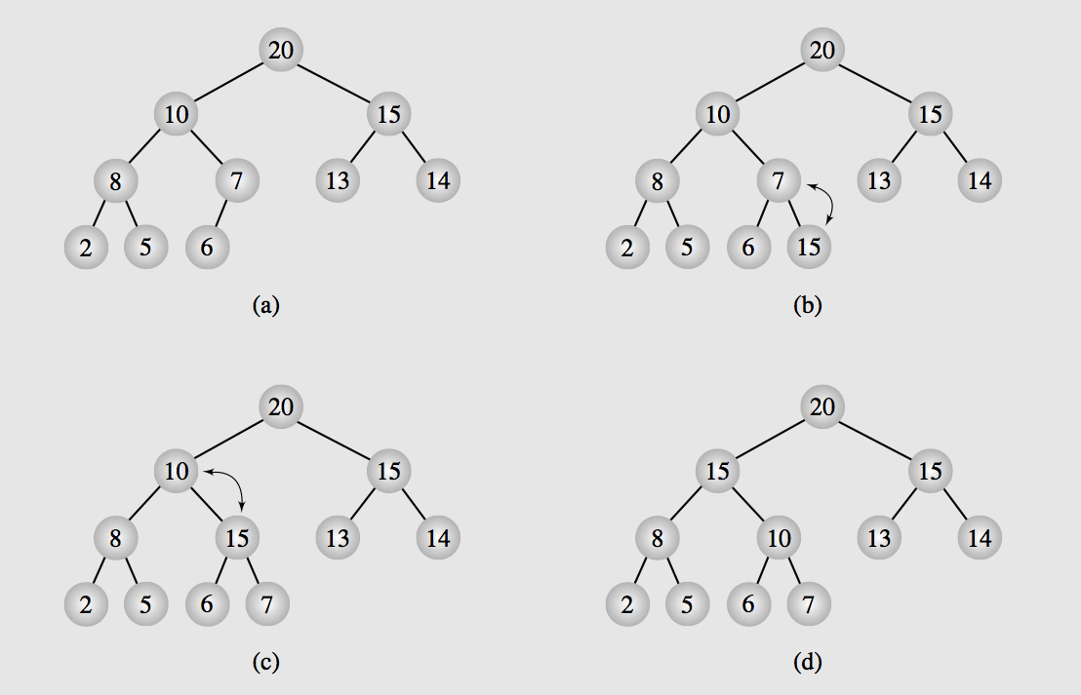
Enqueue to a Heap

Slide 57
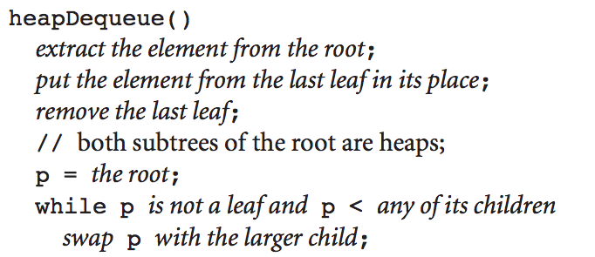
Dequeuing from heap
It means removing root element from heap (the largest)
Then the last leaf is put in its place, this time, moving from the root down the tree.

Slide 58
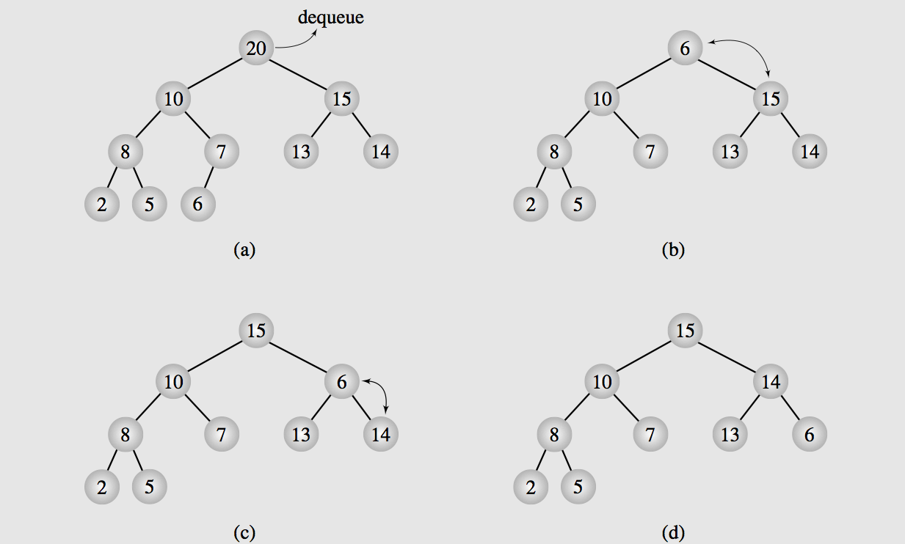
Dequeuing from heap

Slide 59
Organizing arrays as heaps

Slide 60
Heaps and Arrays
Heaps can be implemented as arrays
Each heap is an array
Some arrays are not heaps
So we need to re-organize data in the array to represent a heap
Top-down approach
Start with an empty heap and sequentially include elements into a growing heap.
Floyd algorithm, heap is built bottom-up
Small heaps are formed and repetitively merged into larger heap

Slide 61
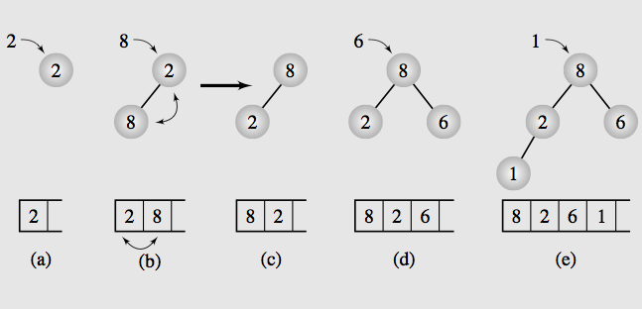
Top-down method
Notes:
http://en.wikipedia.org/wiki/Heapsort#mediaviewer/File:Heapsort-example.gif

Slide 62
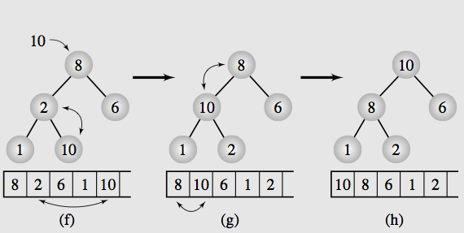
Top-down method

Slide 63
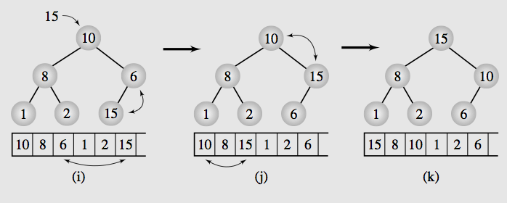
Top-down method

Slide 64
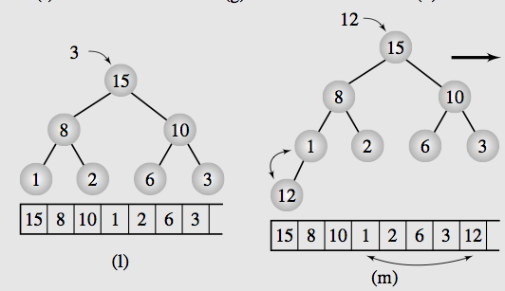
Top-down method

Slide 65
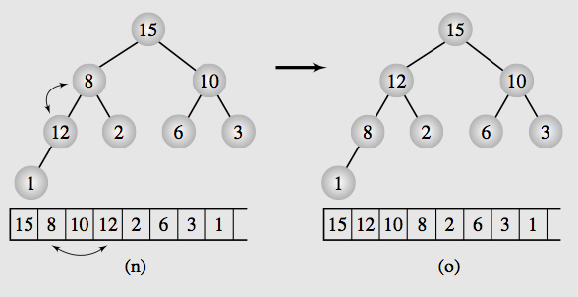
Top-down method

Slide 66
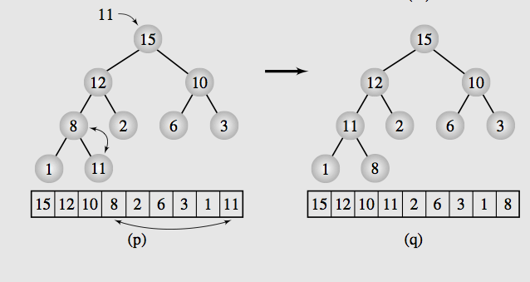
Top-down method

Slide 67
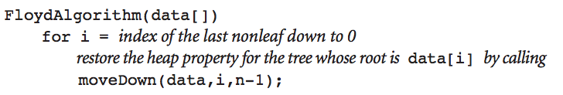
Floyd, Bottom up approach
Start from nonleaf node: data[n/2 -1]
Because we build the tree from left to right, with the left most is the root node and next two elements will be its two children and so on…
[n/2-1] will be the last node which is none-leave
Since in a binary tree: Half of the nodes (if the tree is complete binary tree) will be non-leaves.
First: data[n/2-1] and its children (data[n-1], data[n-2])
Swap data[n/2-1] with its larger child data[n-2] = 12
Next is data[n/2 - 2] and its children (data[n-3], data[n-4])
Swap data[n/2-2] with its larger child data[n-4]
Next is data[n/2-3] = 8, and its children (data[n-5], data[n-6]), the children now is starting to be nonleaf so it starts its merging.

Slide 68
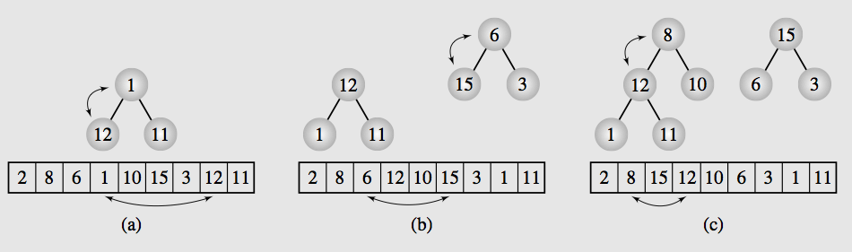
Floyd, Bottom up approach

Slide 69
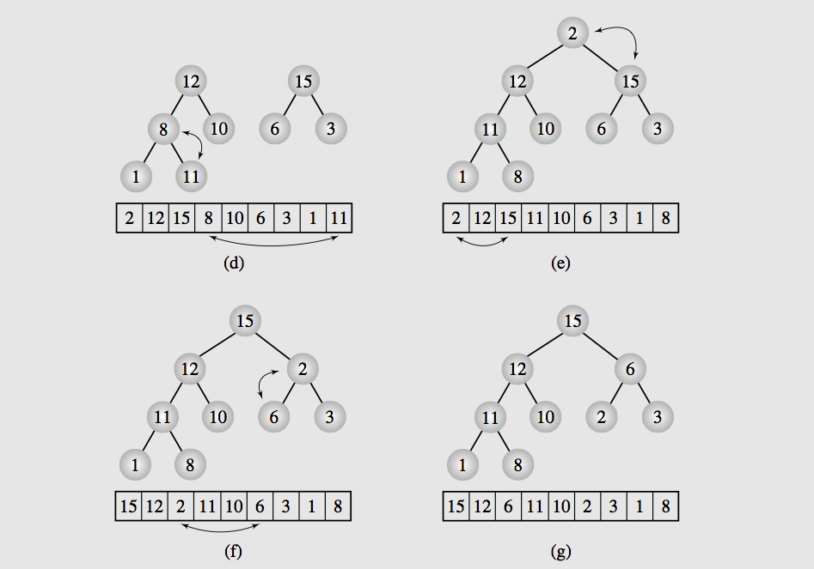
Floyd, Bottom up approach
Notes:
http://en.wikipedia.org/wiki/Heapsort#mediaviewer/File:Heapsort-example.gif

Slide 70
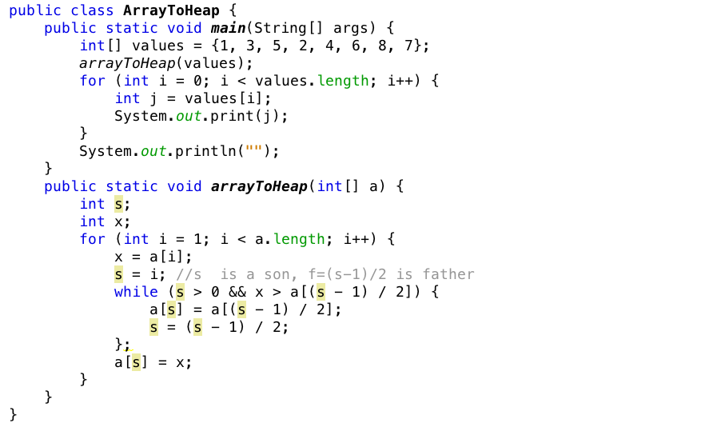
Transforming array to heap
Notes:
http://en.wikipedia.org/wiki/Heapsort#mediaviewer/File:Heapsort-example.gif

Slide 71
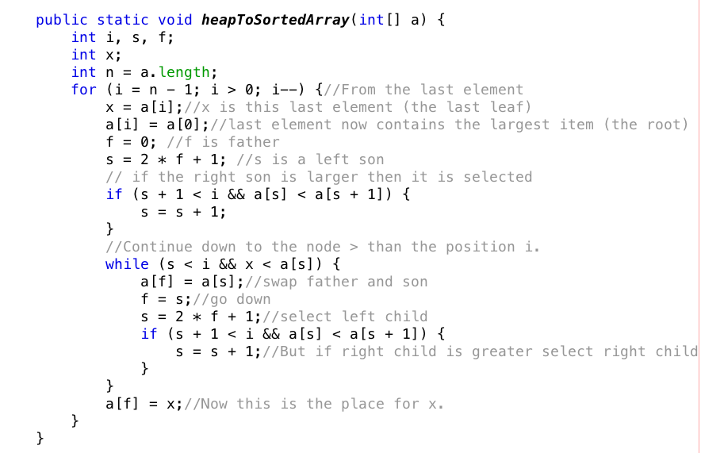
Transforming heap to sorted array
Notes:
http://en.wikipedia.org/wiki/Heapsort#mediaviewer/File:Heapsort-example.gif

Slide 72
Polish Notation and Expression Trees
Polish notation is a special notation for propositional logic that eliminates all parentheses from formulas
(5-6)*7 = *-567
Compiler rejects everything that is not essential to retrieve the proper meaning of formulas

Slide 73
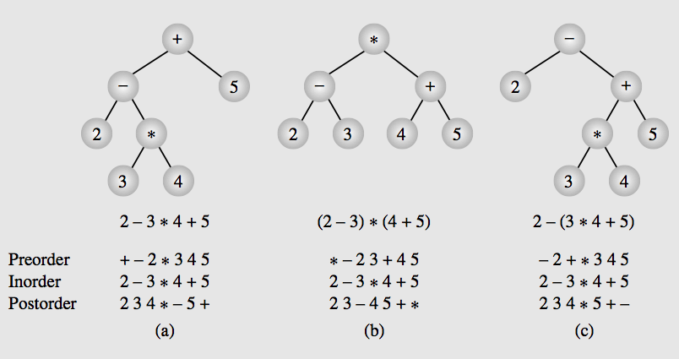
Expression trees & their traversals

Slide 74
Objectives
Trees, Binary Trees, and Binary Search Trees
Tree Traversal
Implementing Binary Trees
Binary Search Tree
Insertion
Deletion
Balancing a Tree
The DSW Algorithm (*)
AVL Trees
Heaps
Polish Notation and Expression Trees (*)
Reading at home
Notes:
Note: (*) Means that students are required to understand essential features only (the problem explanation, definitions, the outline of algorithms…), not in details.

